Slide 1
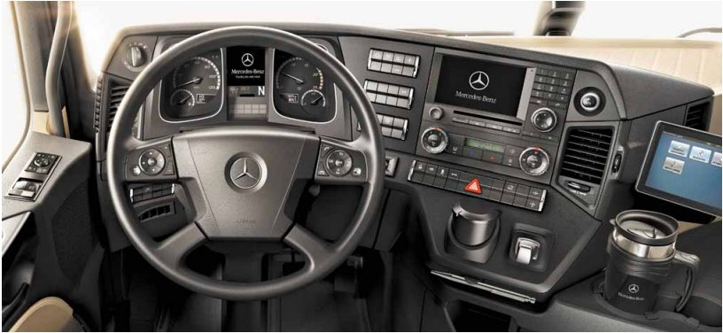
dashboard

Slide 2

Number plate / Licence plate

Slide 3
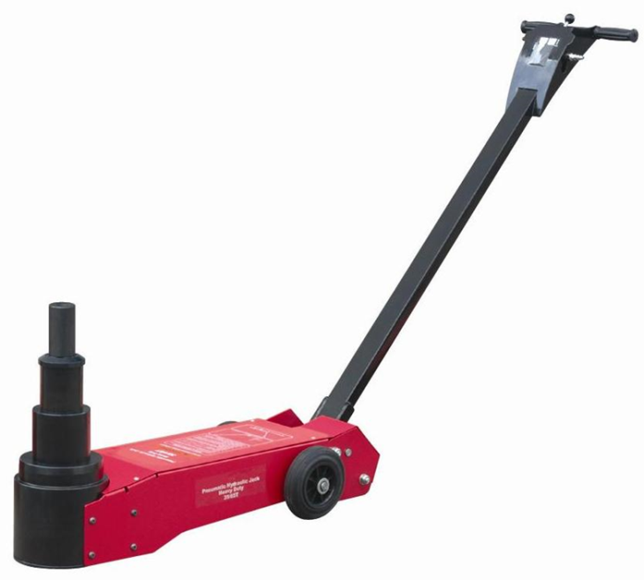
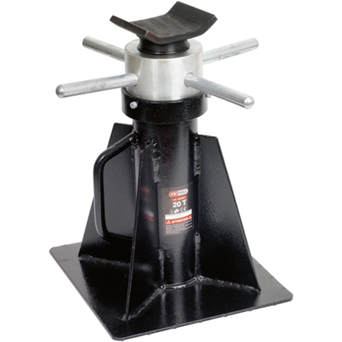
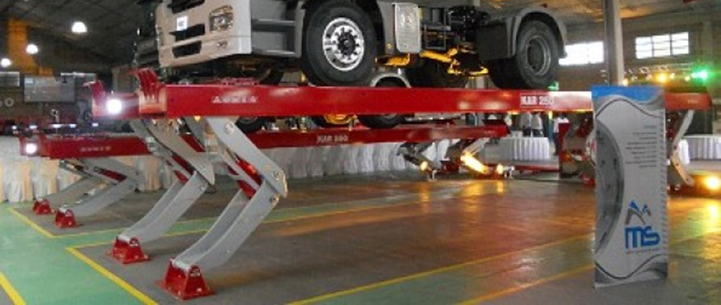
Lifting tools

Slide 4
ABS
Anti blocage System

Slide 5
EBS
Electronic braking system

Slide 6
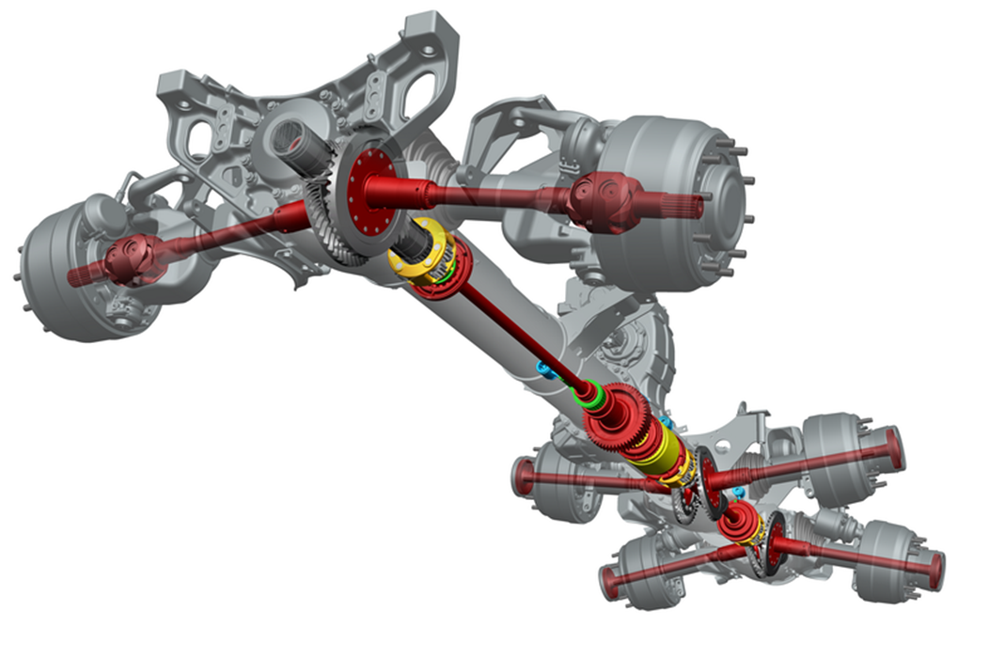
Transmission

Slide 7
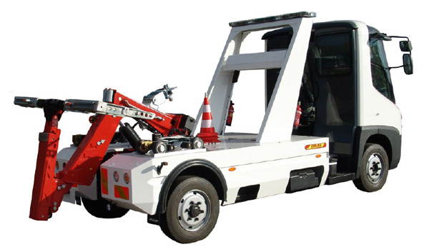
Tow truck

Slide 8
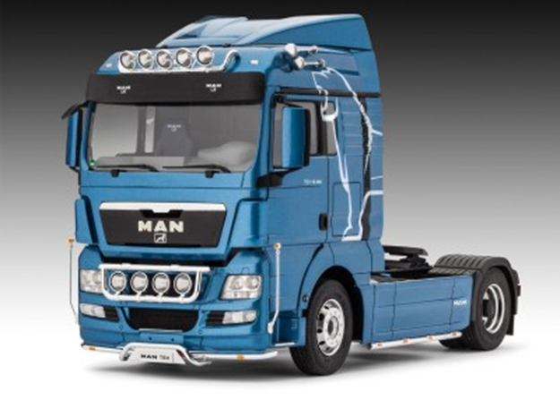
Truck

Slide 9
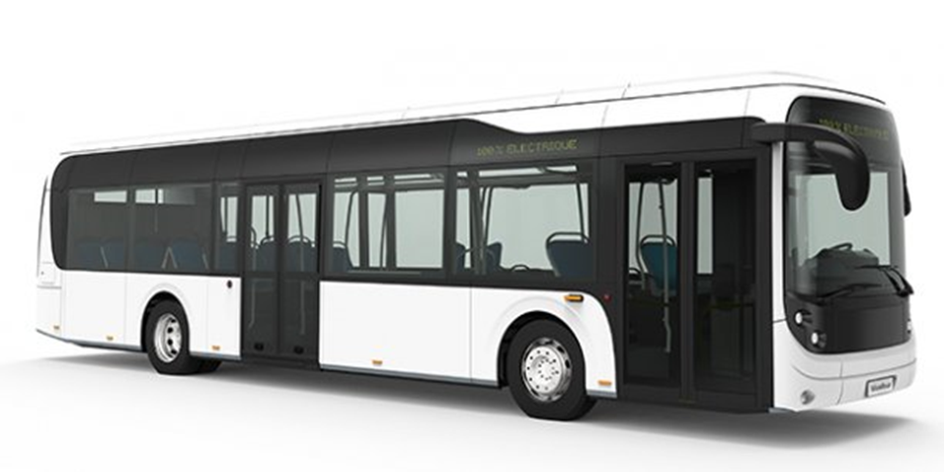
Bus

Slide 10
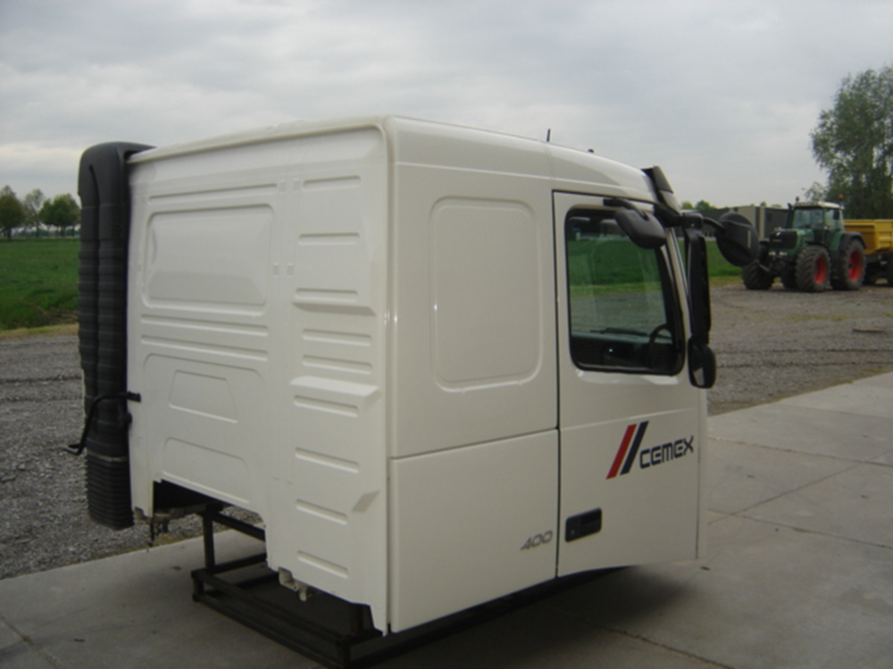
Cab

Slide 11
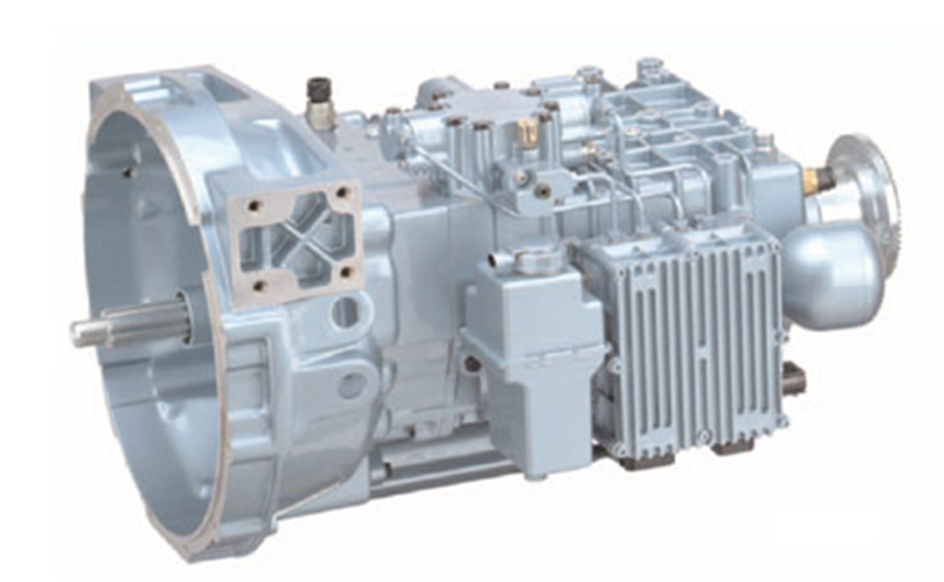
Gearbox

Slide 12
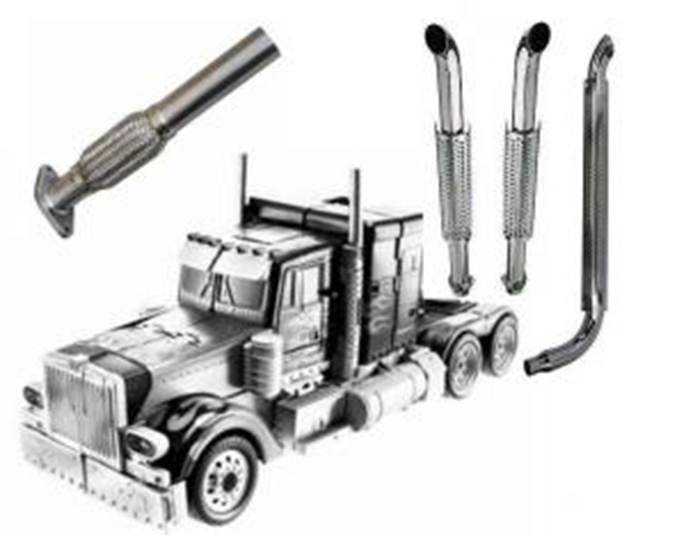
Exhaust

Slide 13
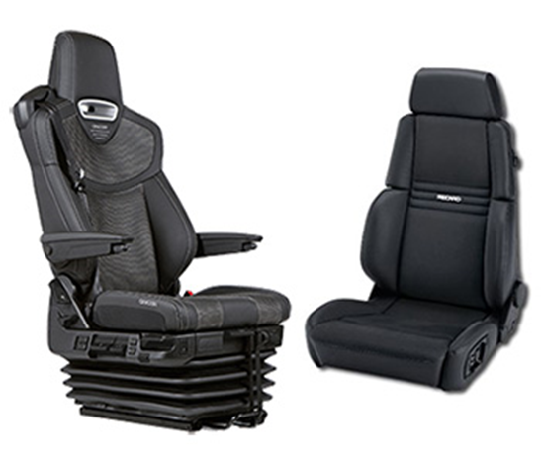
Seats

Slide 14
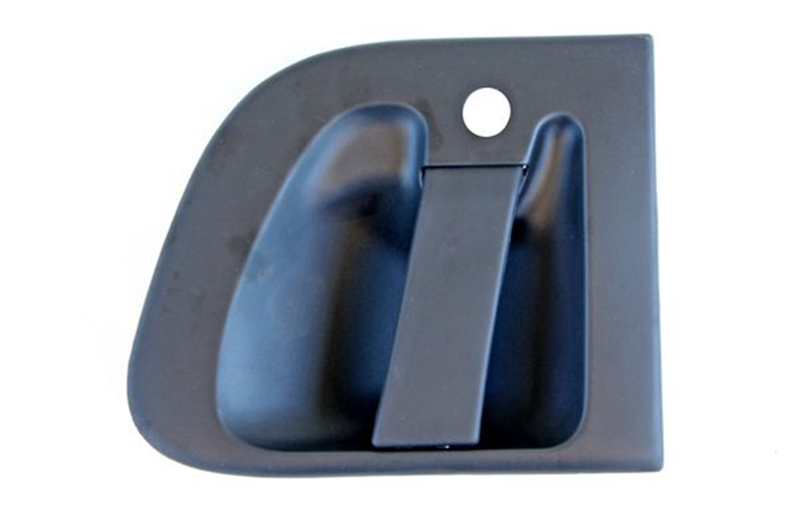
Handle

Slide 15
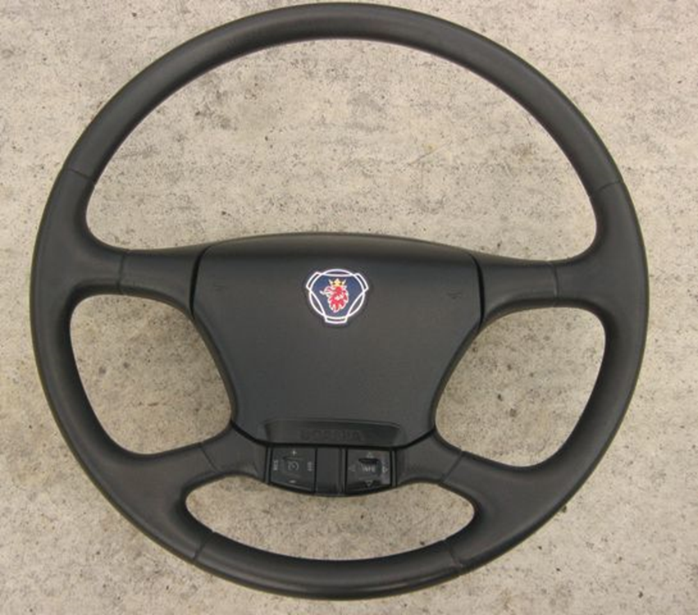
Steering wheel

Slide 16
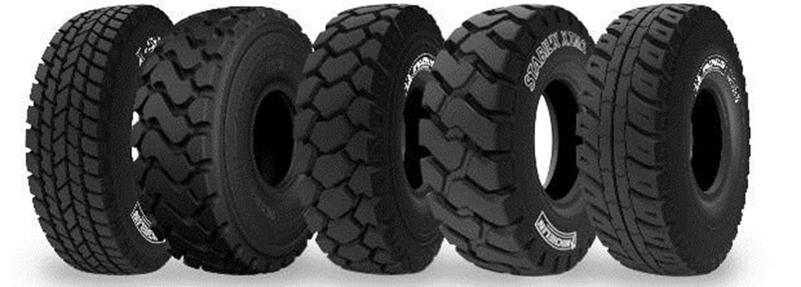
Tyres

Slide 17
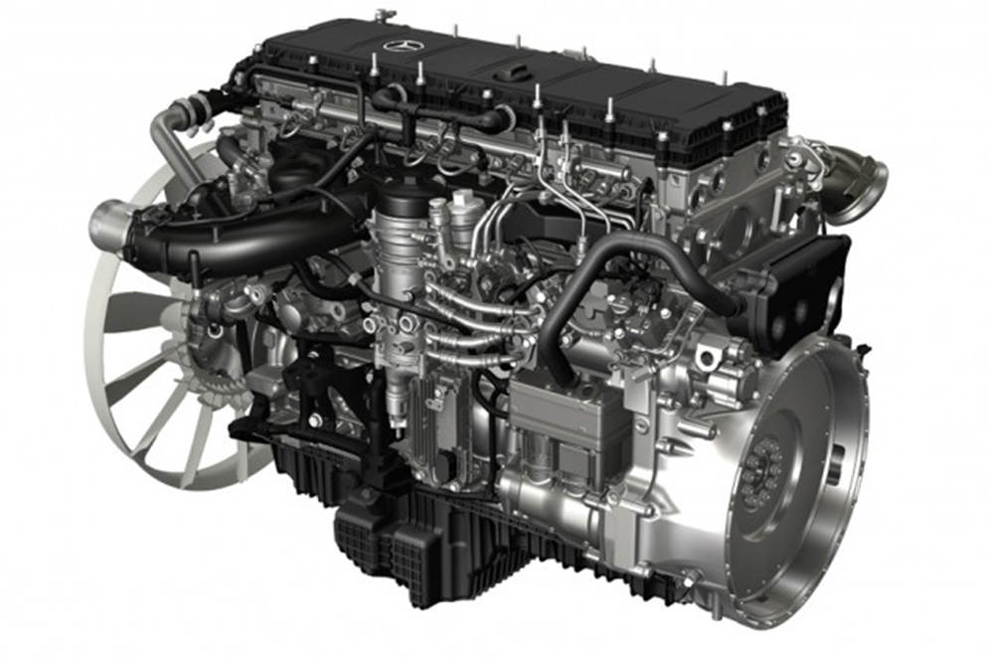
engine

Slide 18
GPS
Global Positioning System

Slide 19
ECU
Electronic control unit

Slide 20
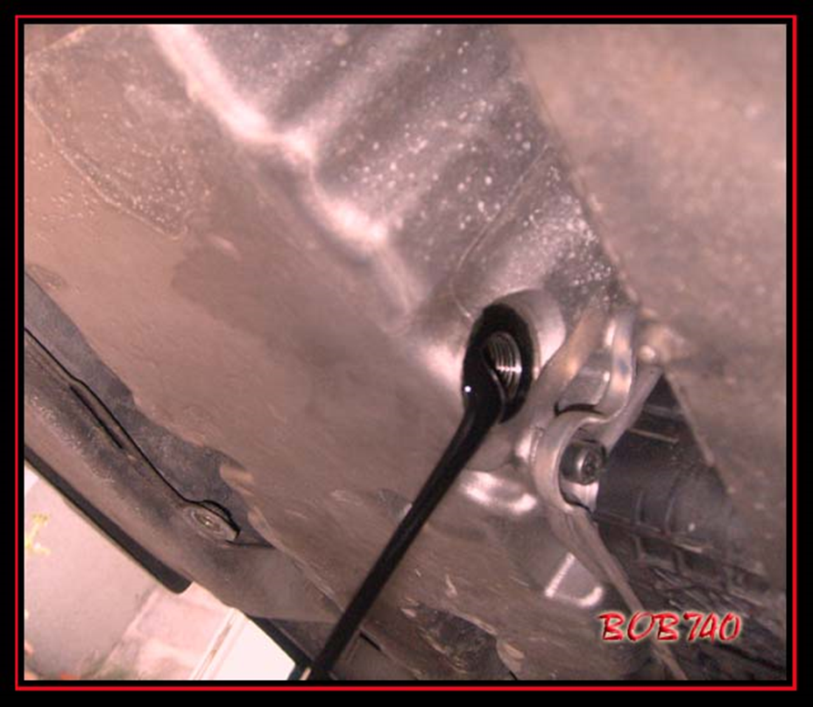
Change oil

Slide 21

Paint

Slide 22
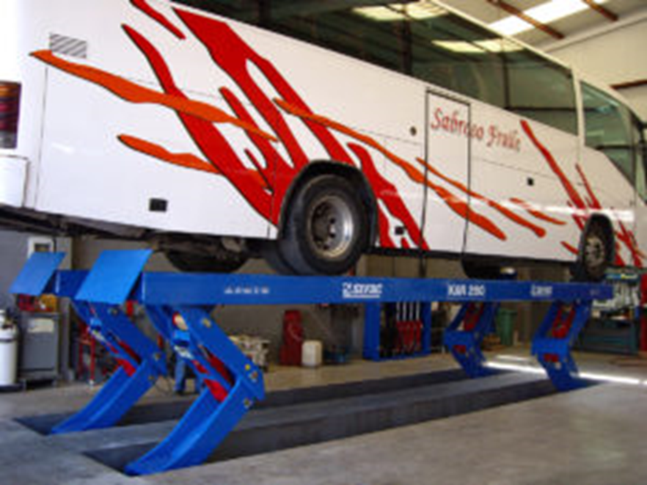
ramp

Slide 23
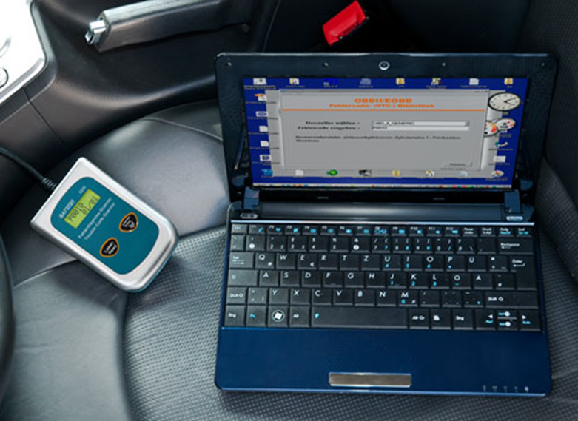
Diagnostic computer

Slide 24

Driving licence

Slide 25

allen key

Slide 26
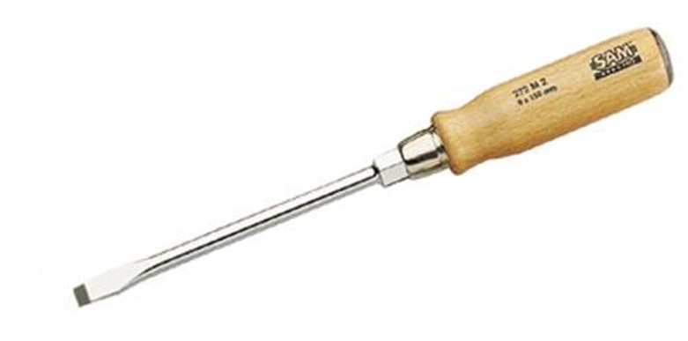
Screwdriver

Slide 27

Pocket light

Slide 28

Hammer

Slide 29

drill

Slide 30
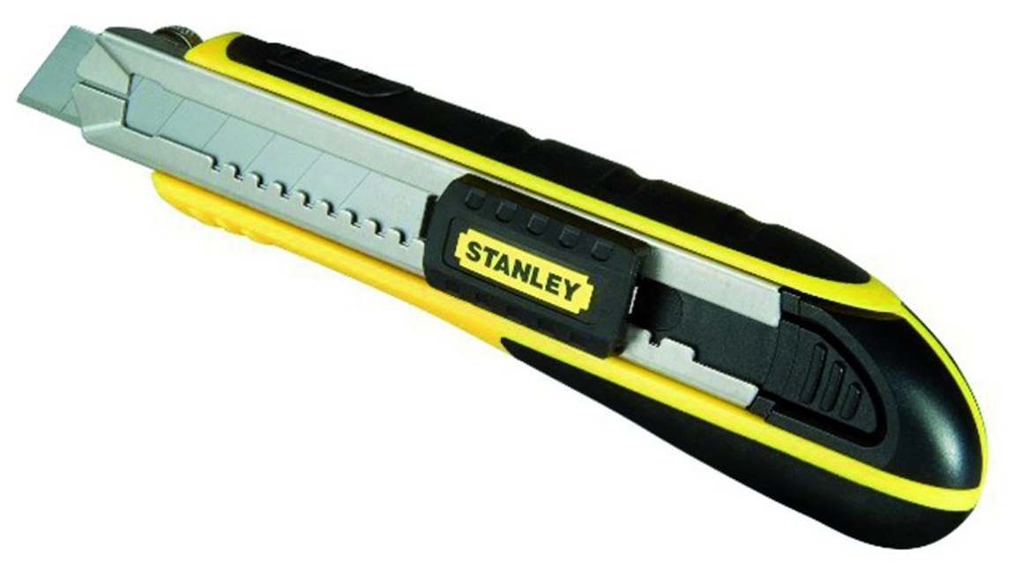
Cutter

Slide 31
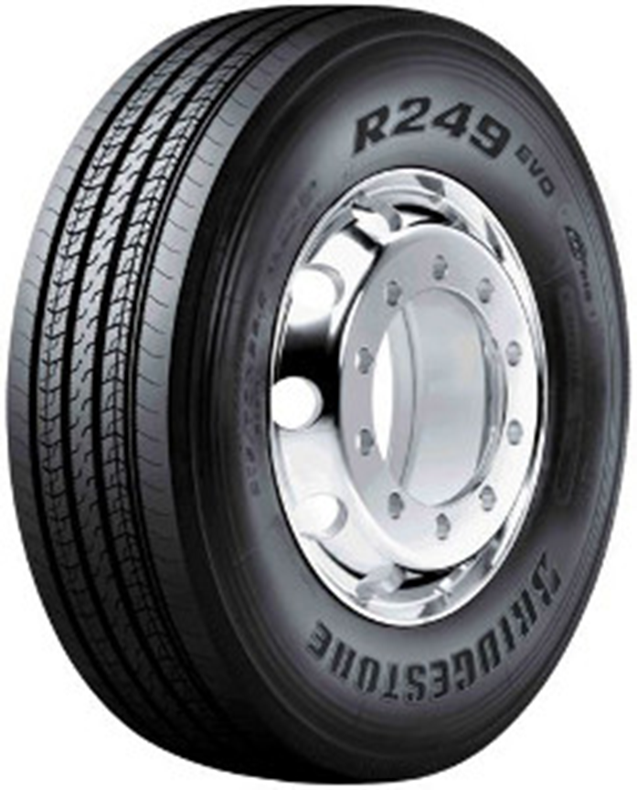
Wheel

Slide 32




fluids

Slide 33
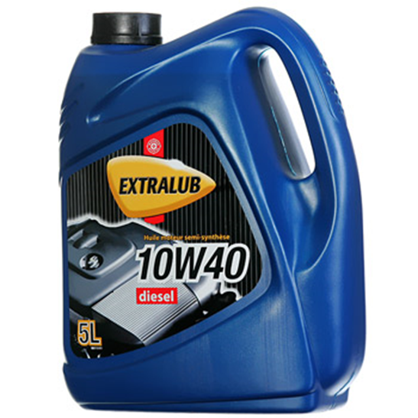
oil

Slide 34

repair

Slide 35

Diagnose (diagnosis)

Slide 36
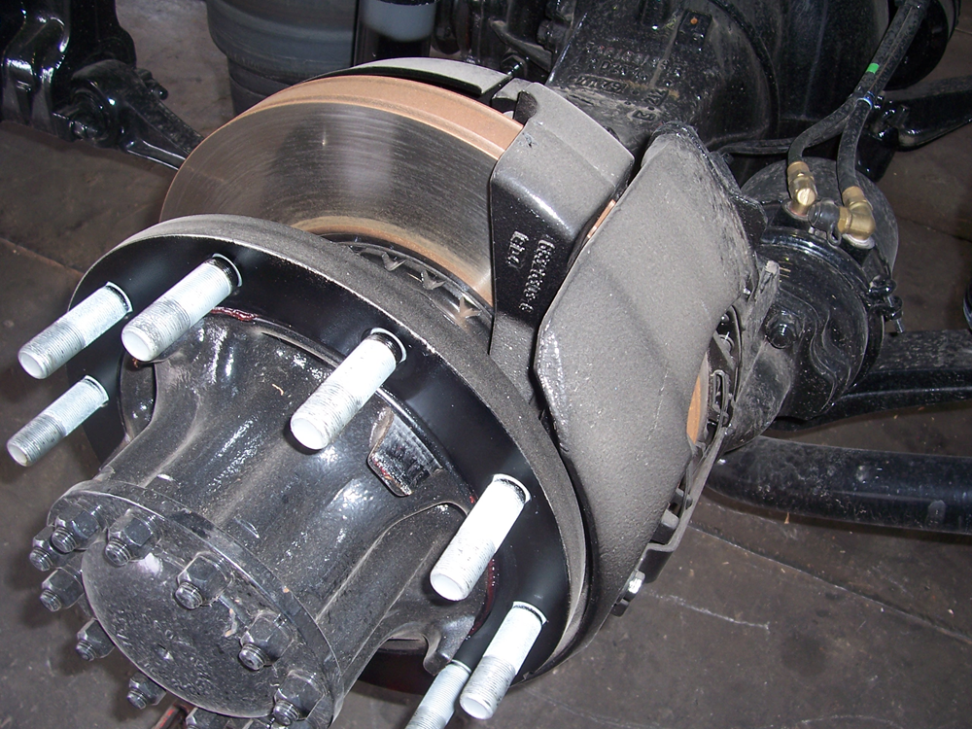
Brakes

Slide 37
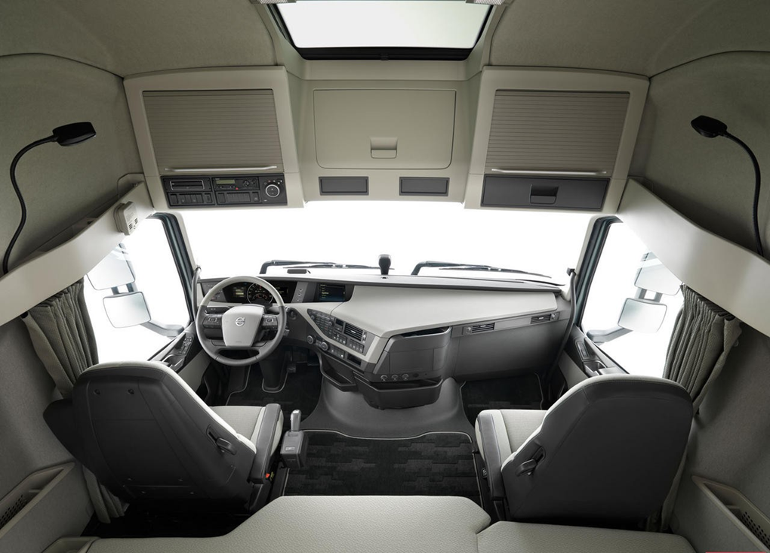
Interior

Slide 38

Bobcat

Slide 39
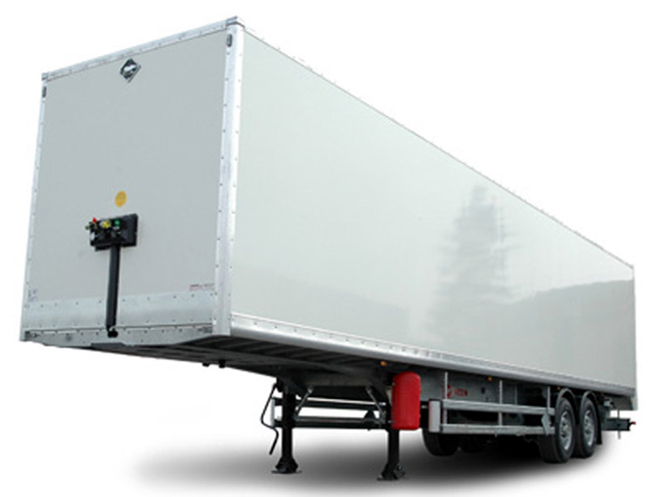
Truck trailer

Slide 40

Trailer truck

