Slide 1
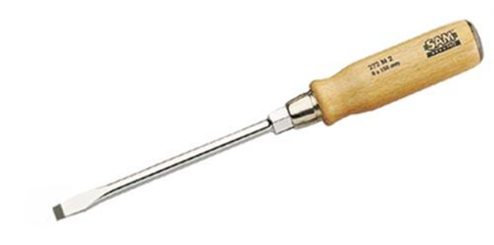

Screwdriver

Slide 2
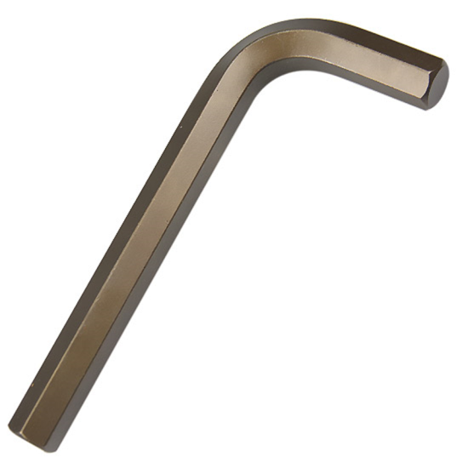
allen key

Slide 3
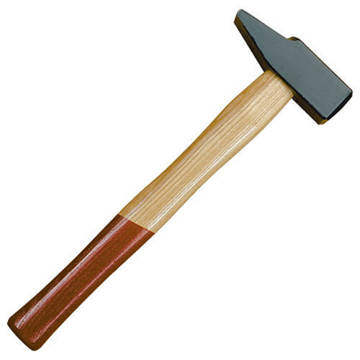
Hammer

Slide 4
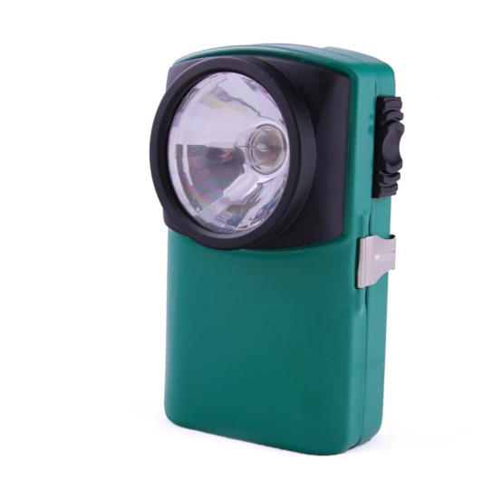
Pocket light

Slide 5

drill

Slide 6
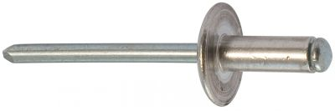
Pop rivet

Slide 7

coolant

Slide 8
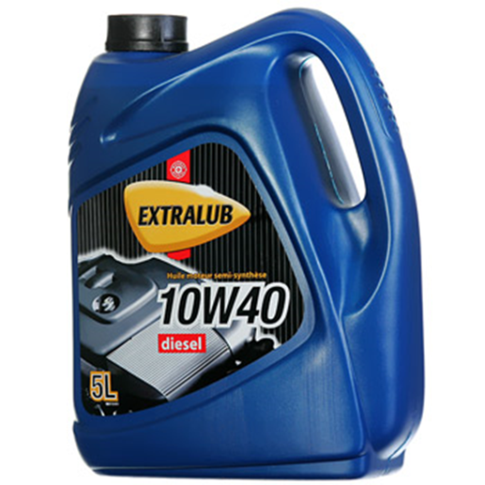
oil

Slide 9



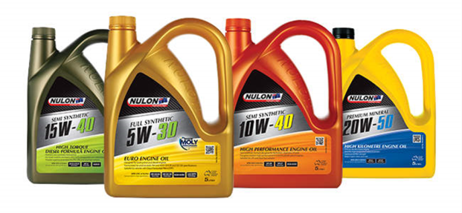
fluids

Slide 10
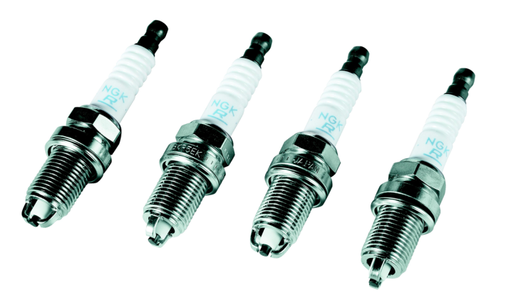
Spark plug

Slide 11
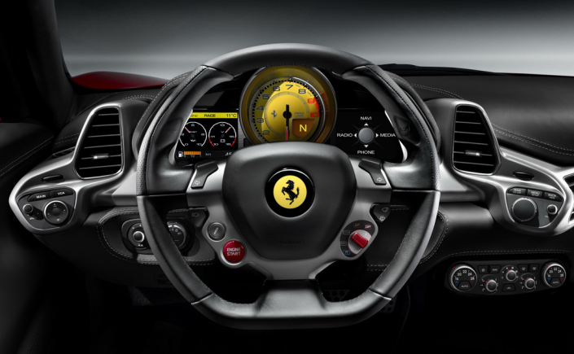
dashboard

Slide 12
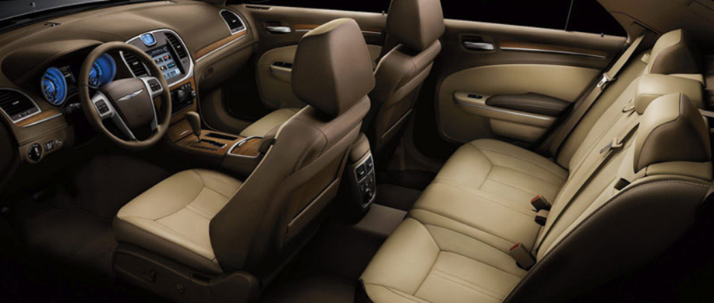
Interior

Slide 13
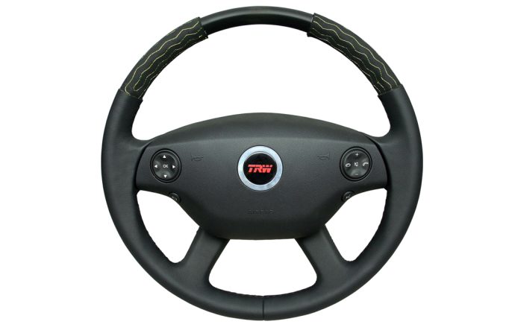
Steering wheel

Slide 14

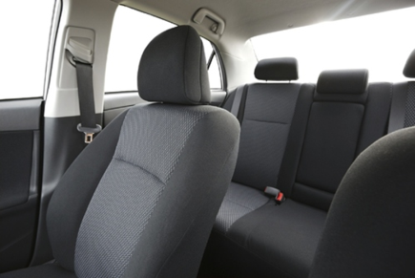
Seats

Slide 15

Tyres

Slide 16
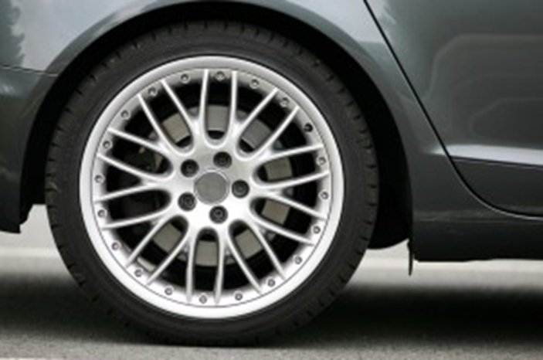
Wheel

Slide 17
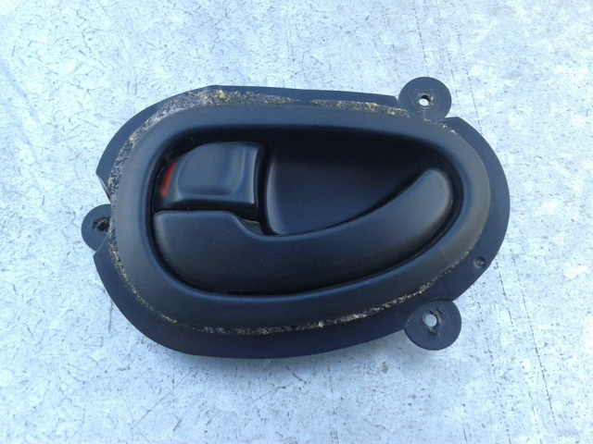
Door handle

Slide 18
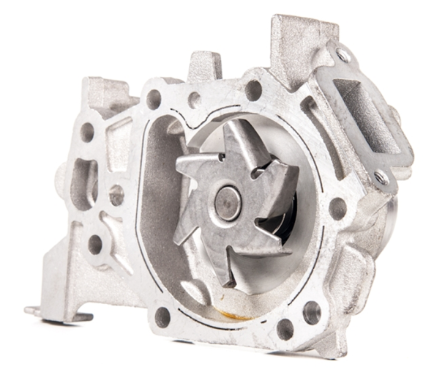
Water pump

Slide 19
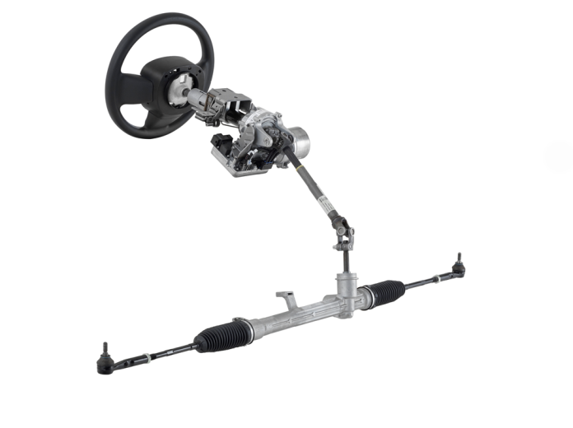
steering

Slide 20
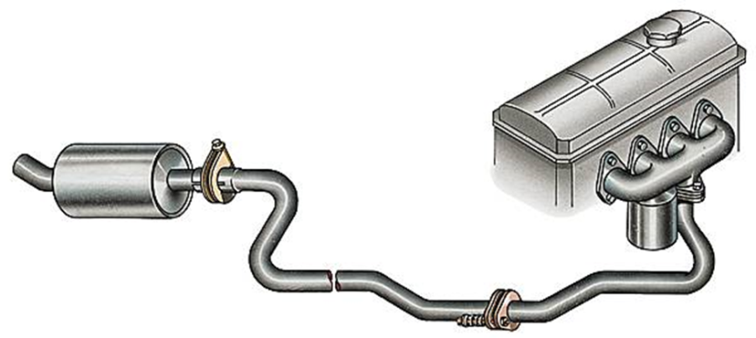
Exhaust

Slide 21
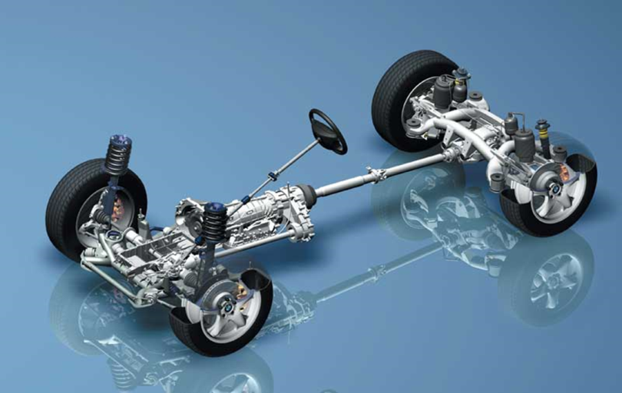
Transmission

Slide 22
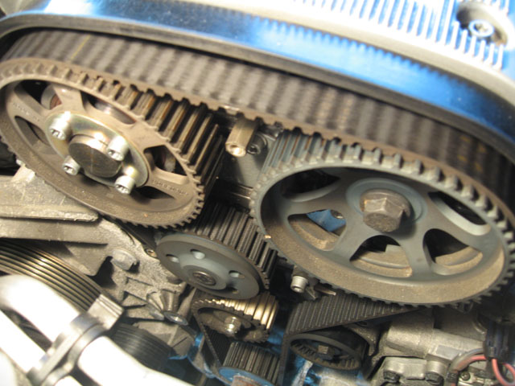
Valve Timing

Slide 23
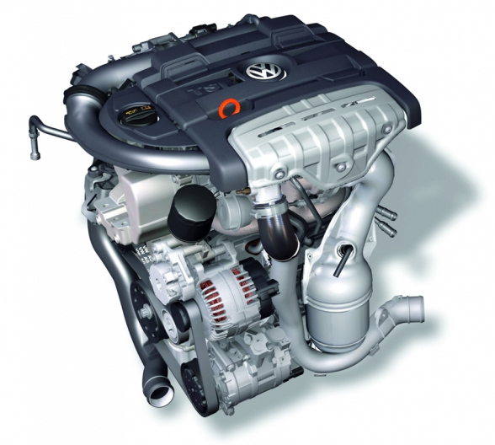
Engine

Slide 24
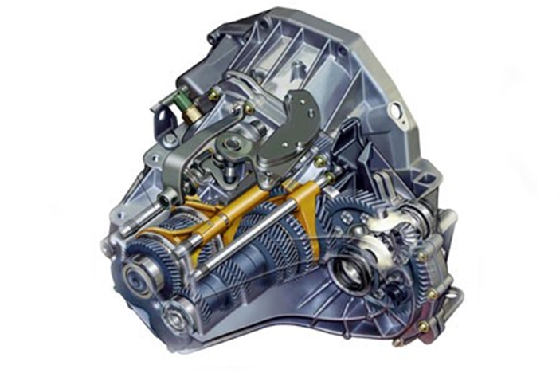
Gearbox

Slide 25
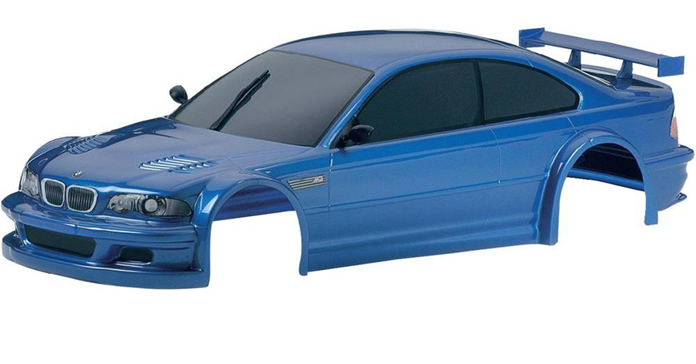
Car body

Slide 26

repair

Slide 27
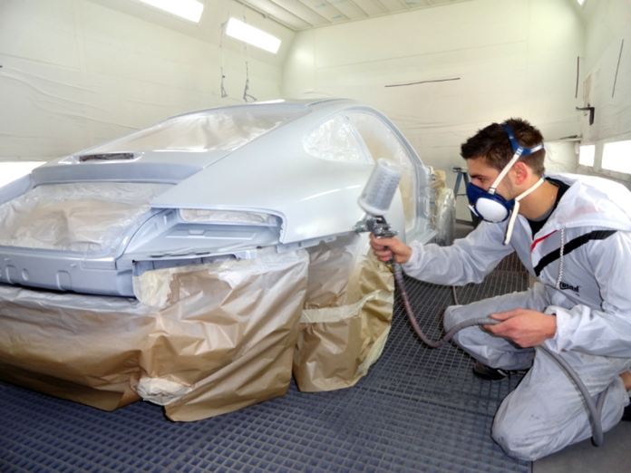
Paint

Slide 28
GPS
Global Positioning System

Slide 29
ABS
Antilock braking System

Slide 30
ESP
Electronic stability Program

Slide 31
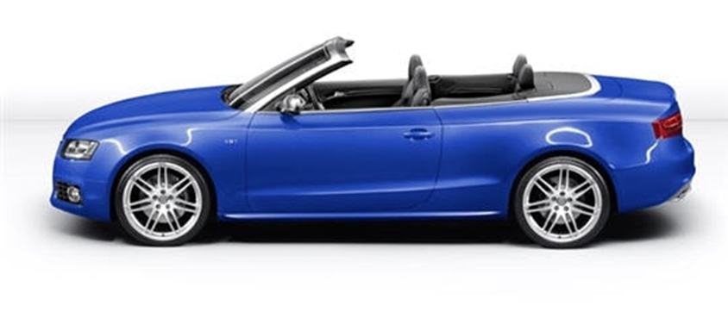
convertible

Slide 32

Four wheel drive

Slide 33
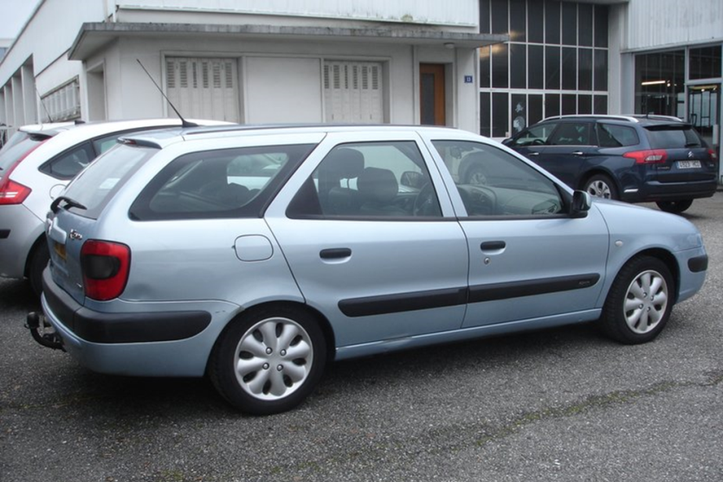
Station wagon

Slide 34
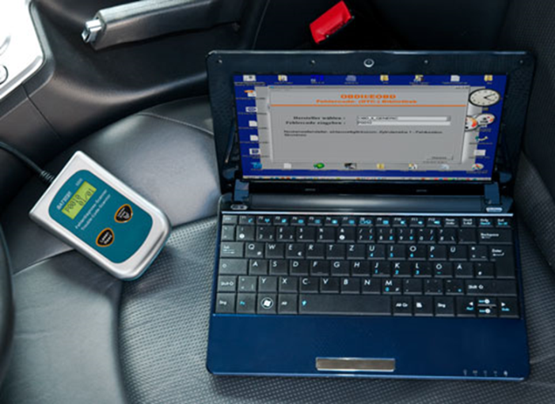
Diagnostic computer

Slide 35
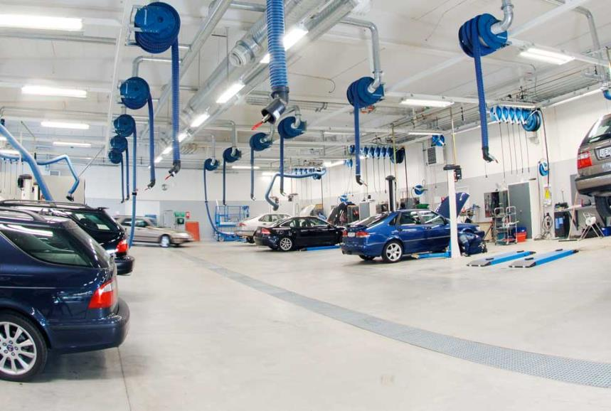
Workshop (car repair)

Slide 36

Change oil

Slide 37

Technician/mechanic

Slide 38

Diagnostics

Slide 39
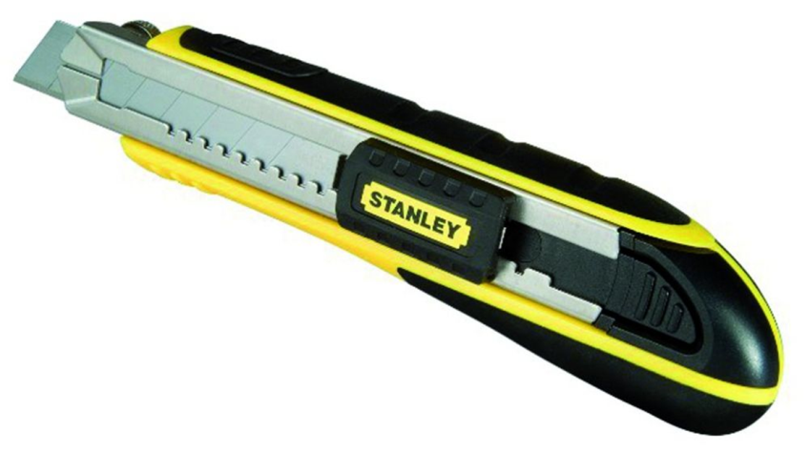
Cutter

Slide 40
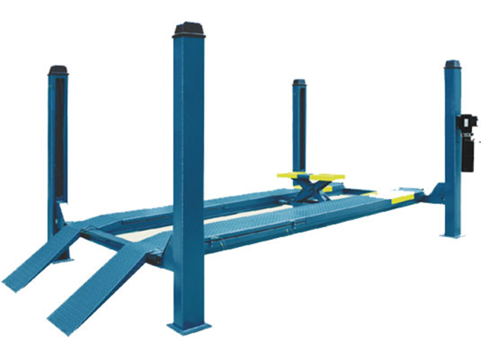
Car lift - ramp

Slide 41
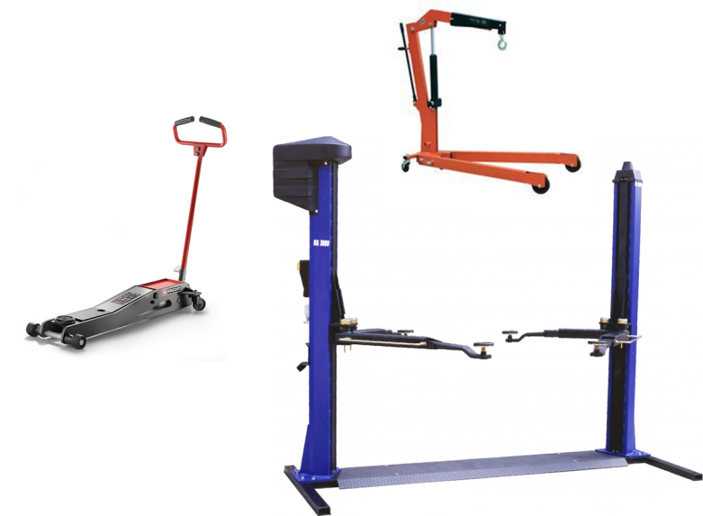
Lifting tools

Slide 42
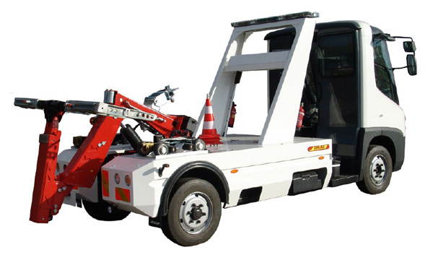
Tow truck

Slide 43

number plate

Slide 44
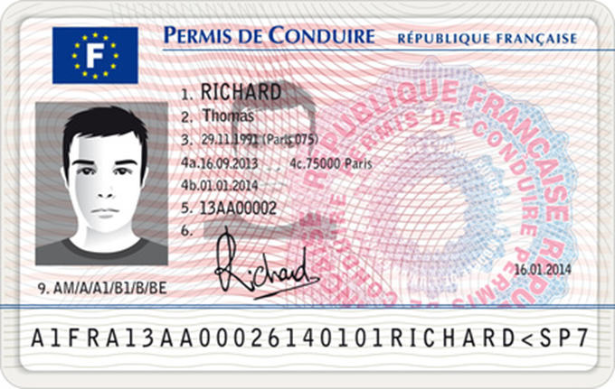
Driving licence

