Slide 1
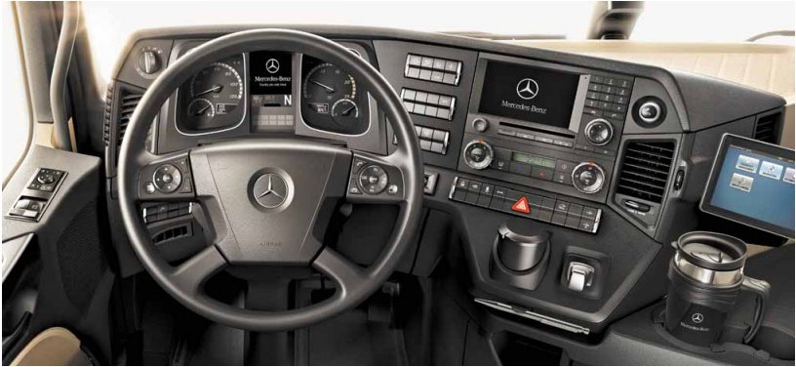
dashboard

Slide 2

Number plate / Licence plate

Slide 3
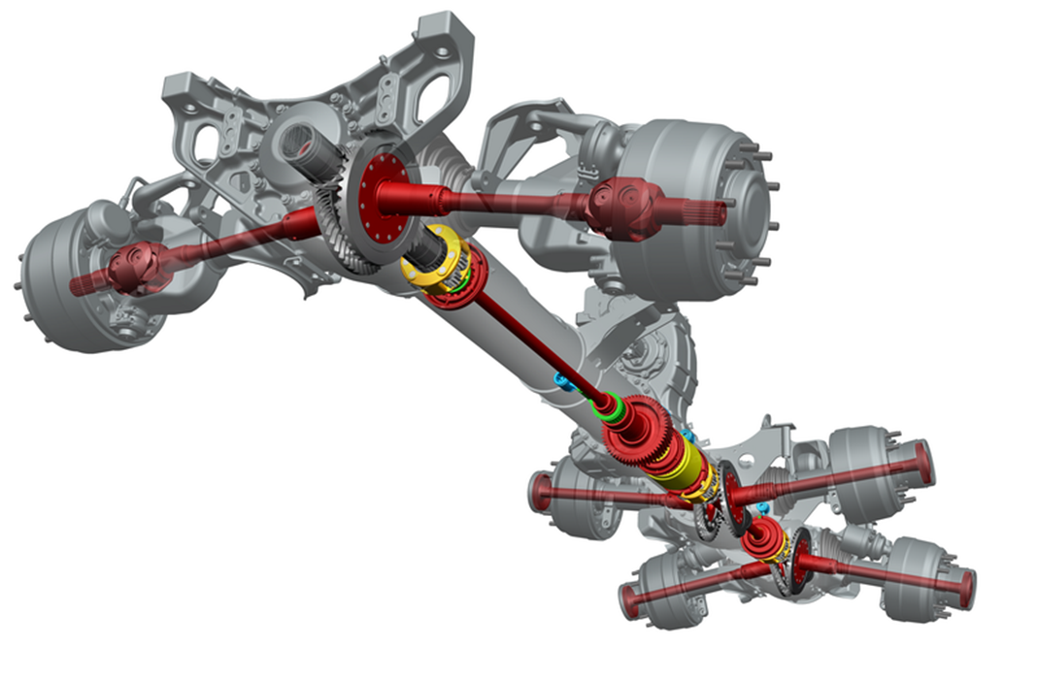
Transmission

Slide 4
ABS
Anti blocage System

Slide 5
EBS
Electronic braking system

Slide 6
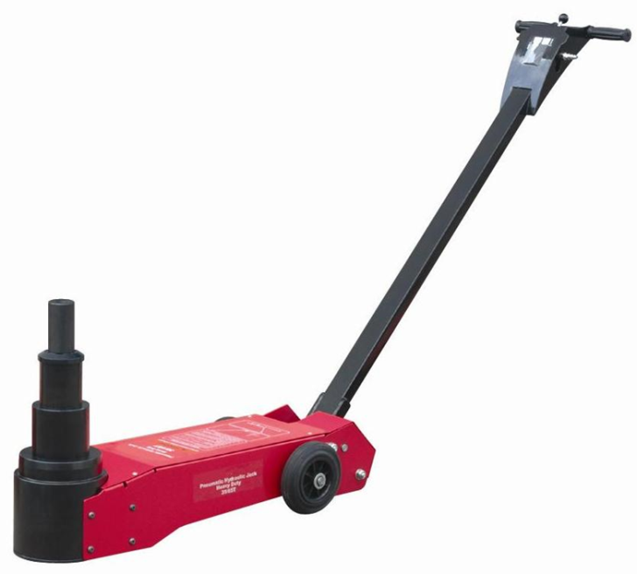
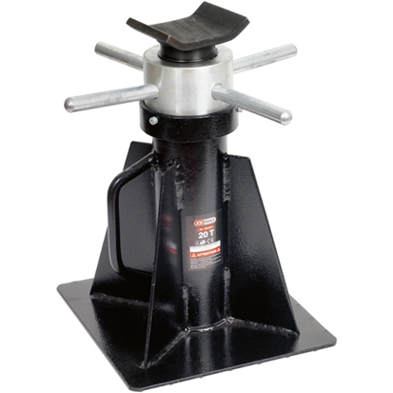
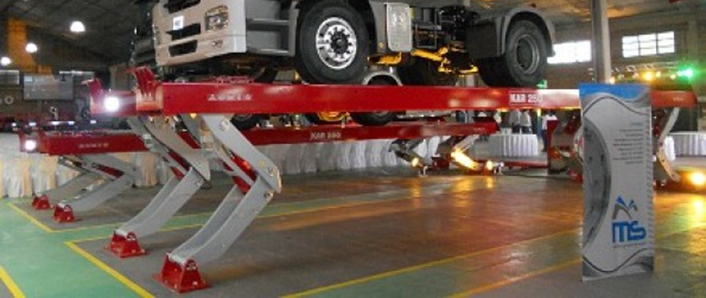
Lifting tools

Slide 7
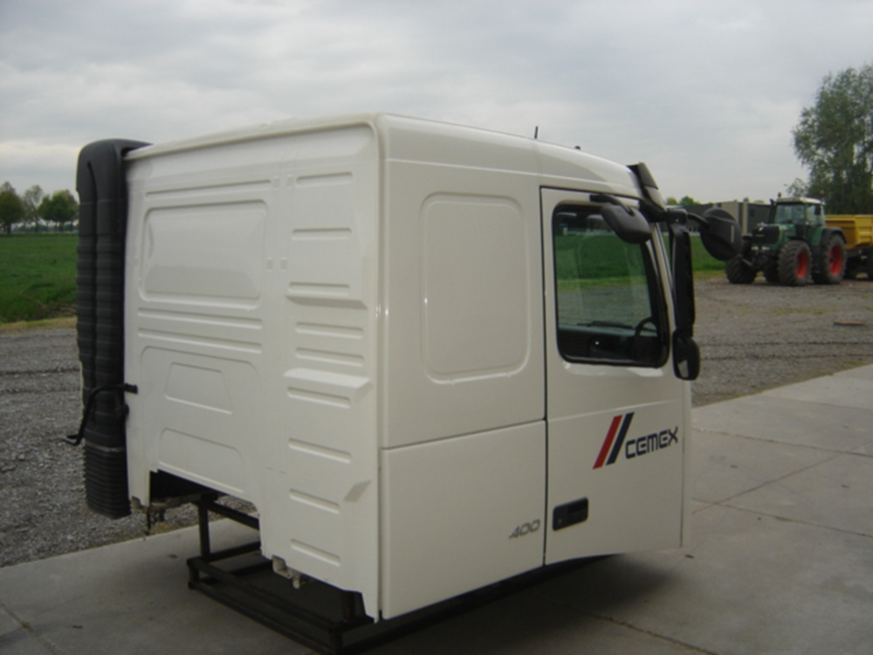
Cab

Slide 8

allen key

Slide 9
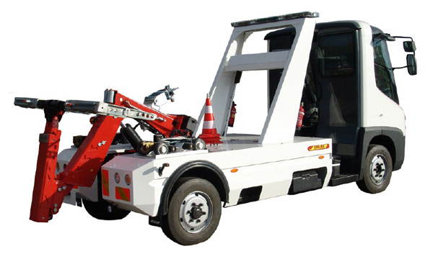
Tow truck

Slide 10
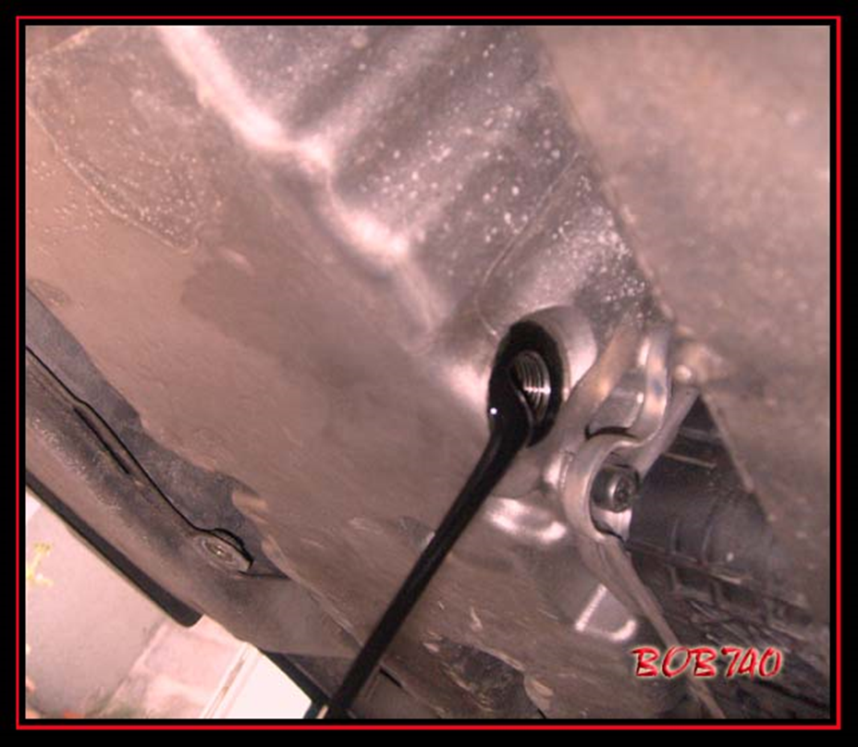
Change oil

Slide 11
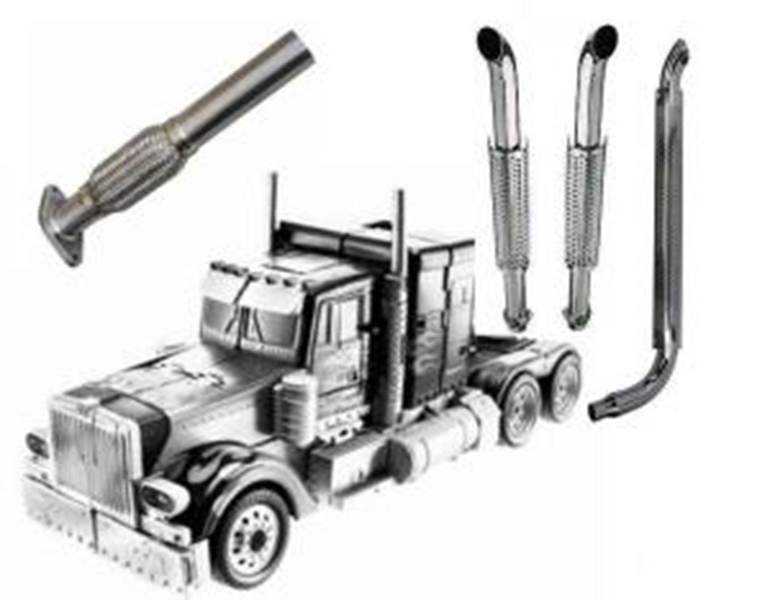
Exhaust

Slide 12
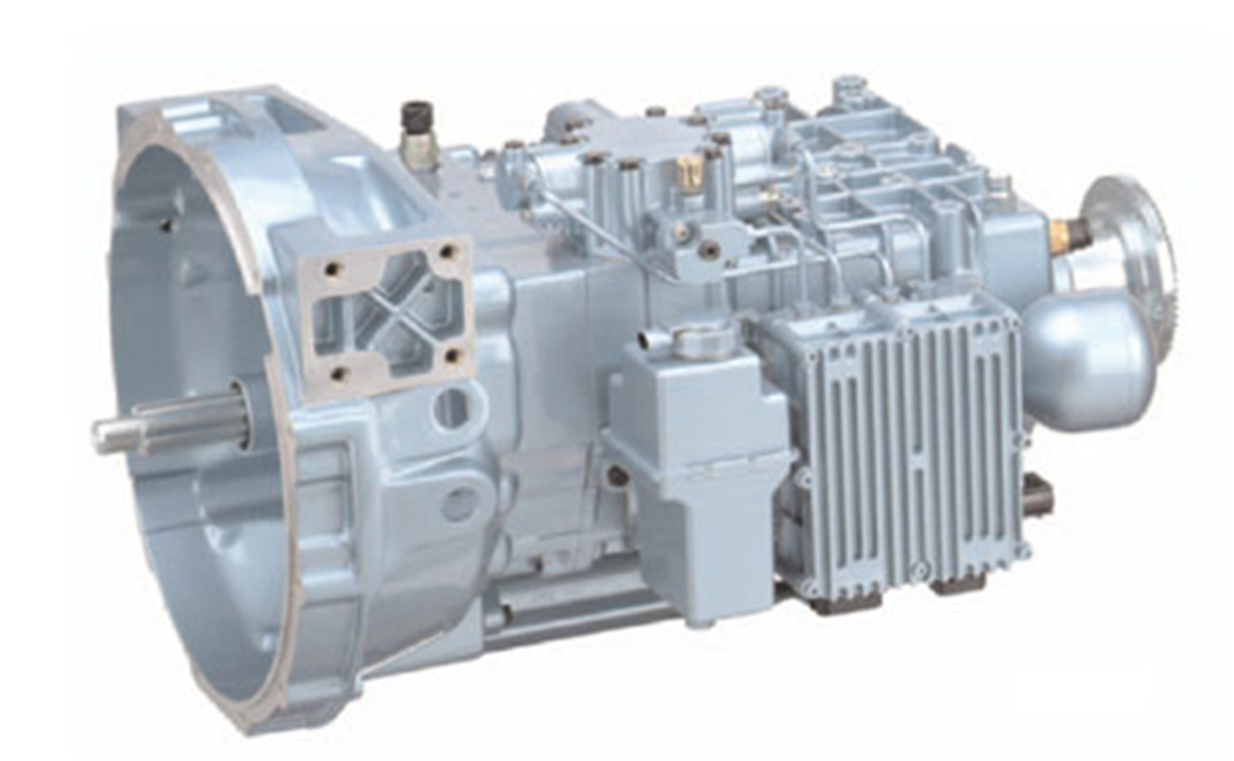
Gearbox

Slide 13
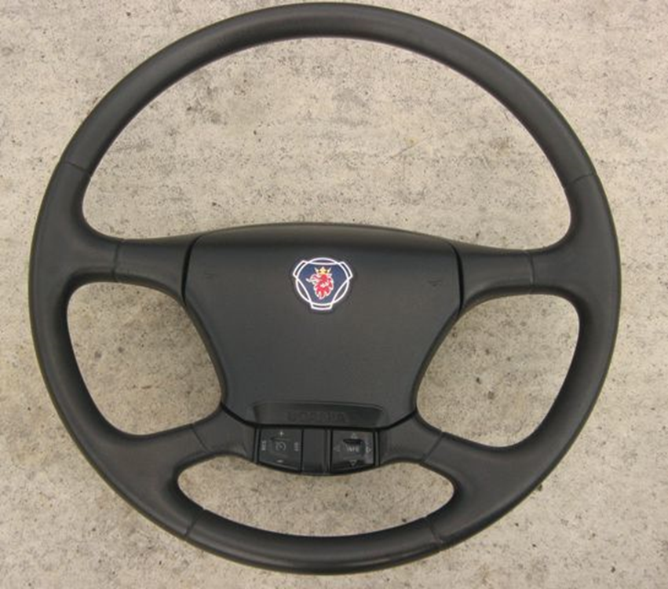
Steering wheel

Slide 14

Seats

Slide 15

Bus

Slide 16
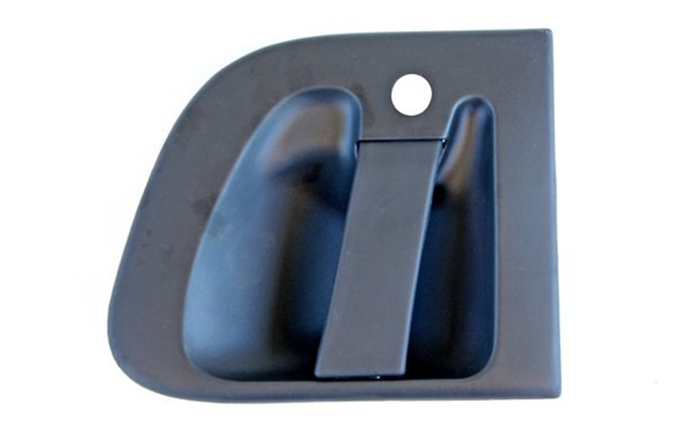
Handle

Slide 17
GPS
Global Positioning System

Slide 18
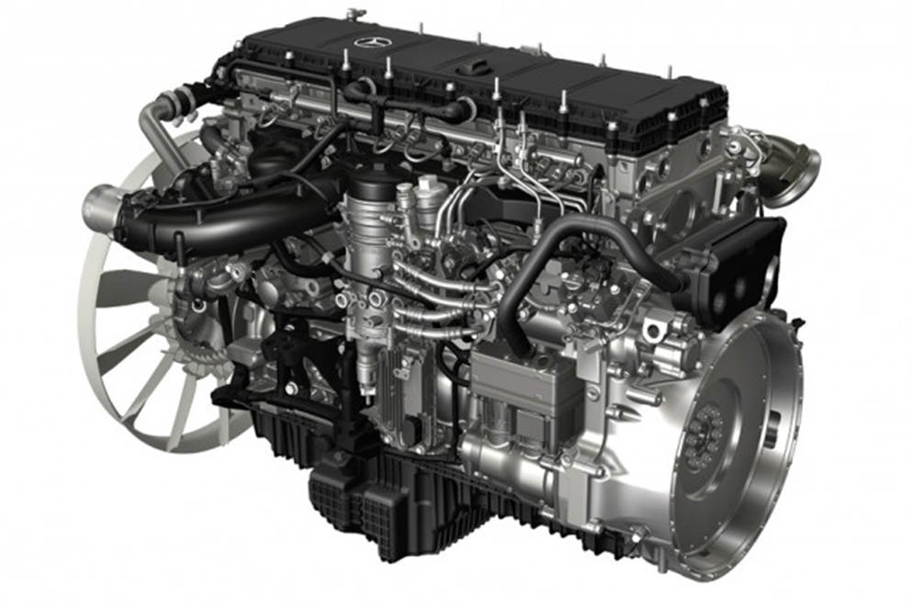
engine

Slide 19
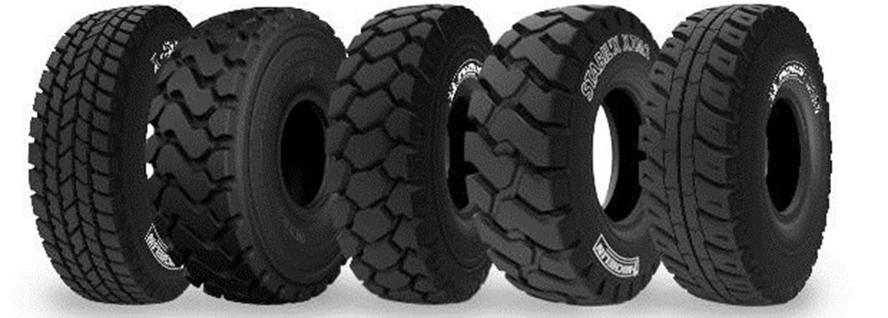
Tyres

Slide 20
ECU
Electronic control unit

Slide 21
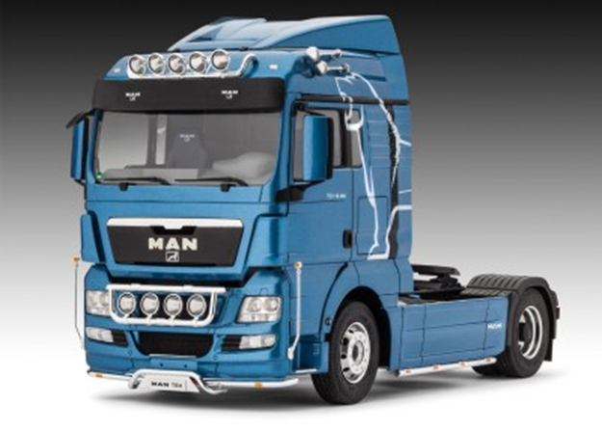
Truck

Slide 22
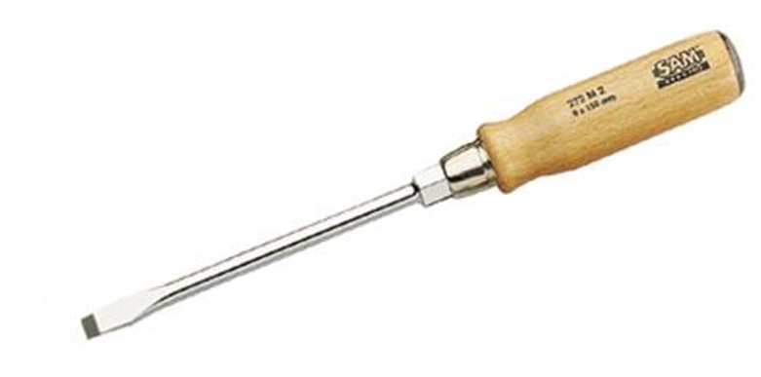
Screwdriver

Slide 23

Paint

Slide 24

Driving licence

Slide 25
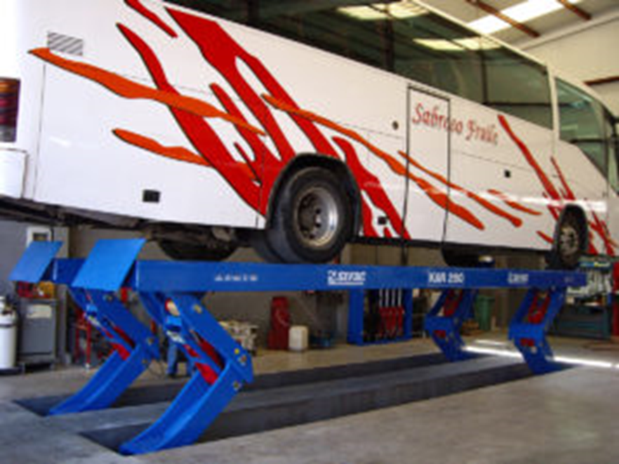
ramp

Slide 26

drill

Slide 27
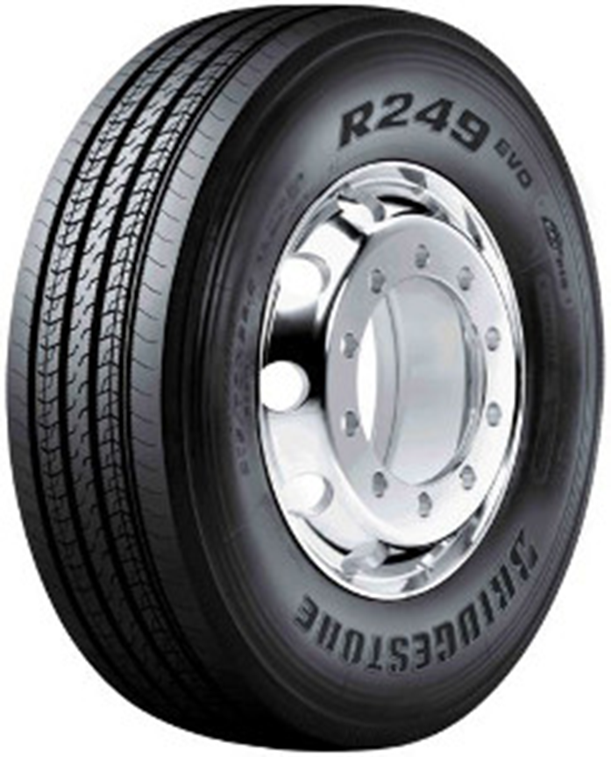
Wheel

Slide 28

Hammer

Slide 29
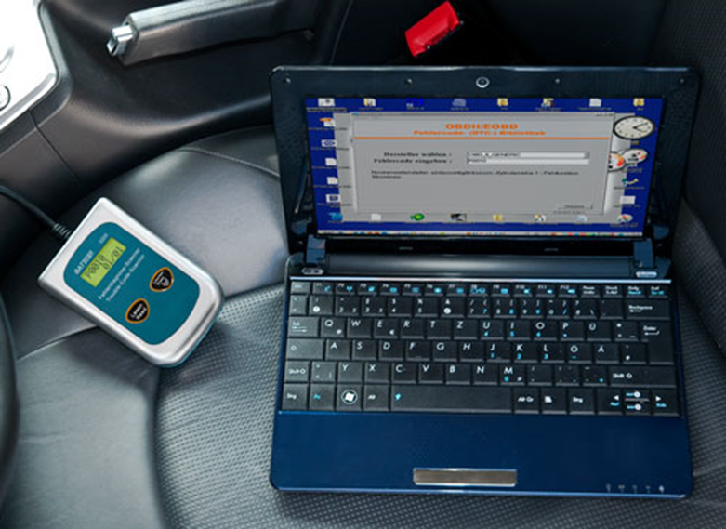
Diagnostic computer

Slide 30
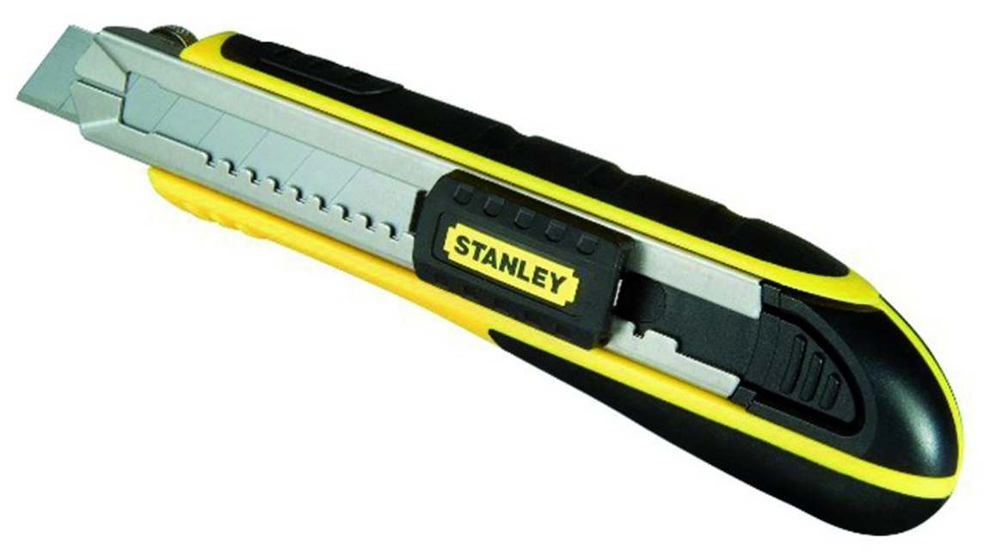
Cutter

Slide 31

Pocket light

Slide 32




fluids

Slide 33

repair

Slide 34
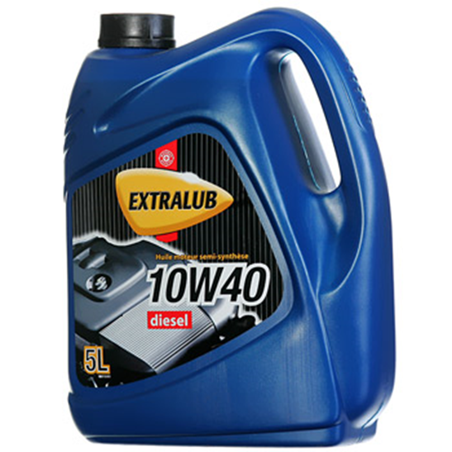
oil

Slide 35
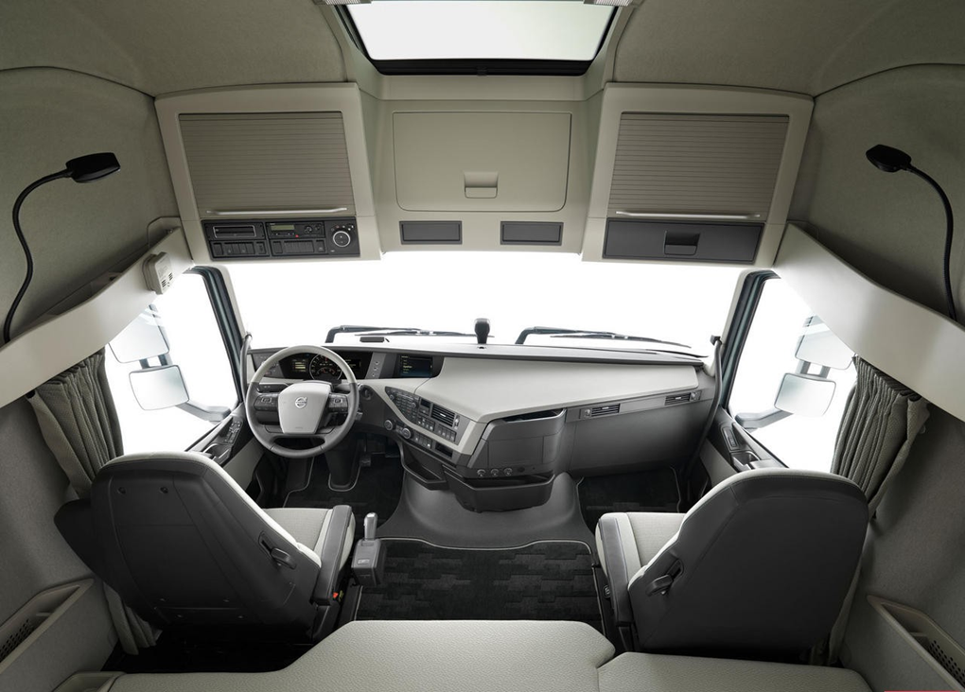
Interior

Slide 36

Diagnose (diagnosis)

Slide 37

Bobcat

Slide 38
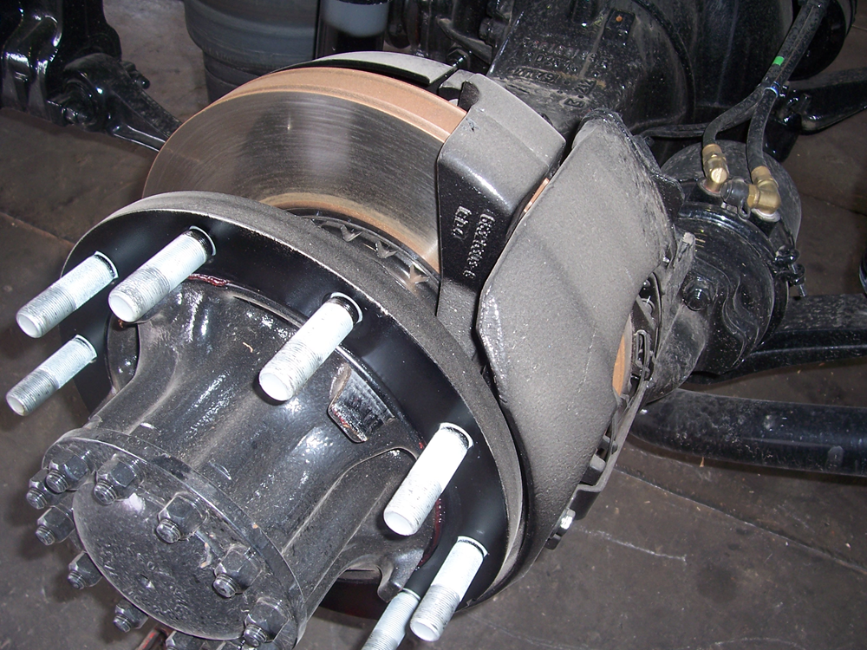
Brakes

Slide 39
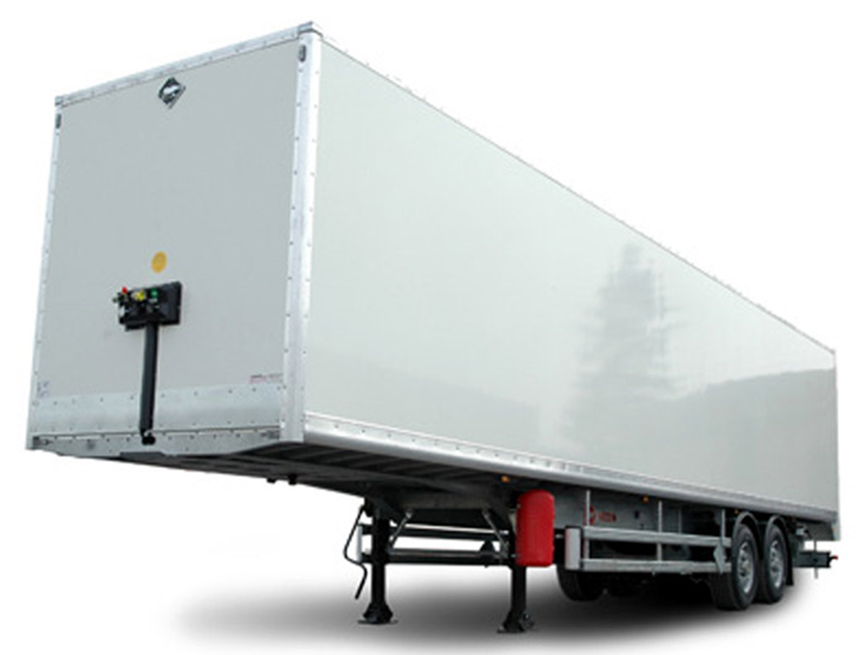
Truck trailer

Slide 40

Trailer truck

